Slide 1
Digital System Design CE 325 L1 SPRING 2024
Instructor : Dr. Syed Arsalan Jawed
Associate Professor of Practice
arsalan.jawed@sse.habib.edu.pk
Room : W-301
Office Hours : Monday 0930-1030, Wednesday 1430-1530, Friday 0930-1030

Slide 2

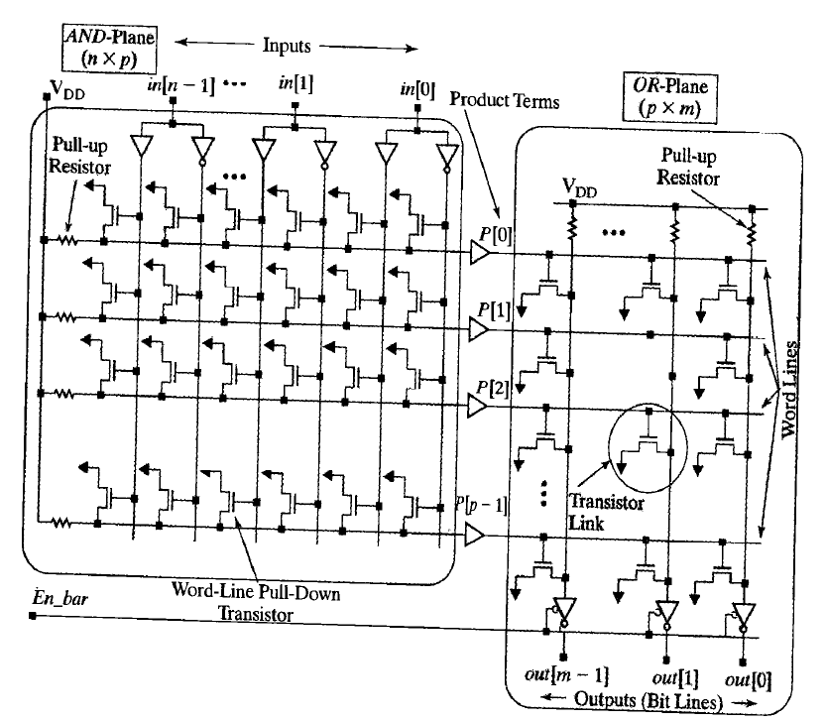
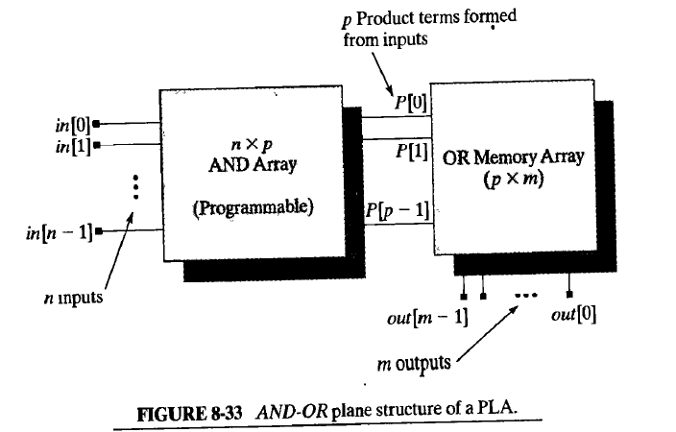
Programmable Logic Array

Slide 3

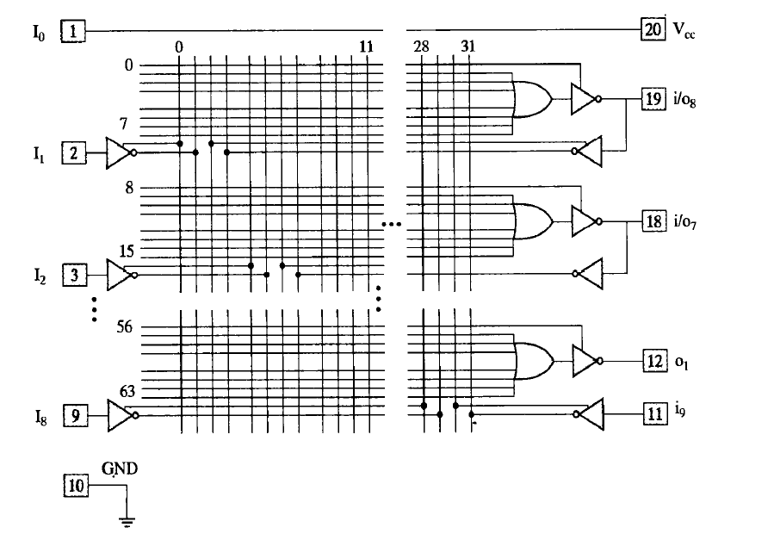
Programmable Array Logic

Slide 4
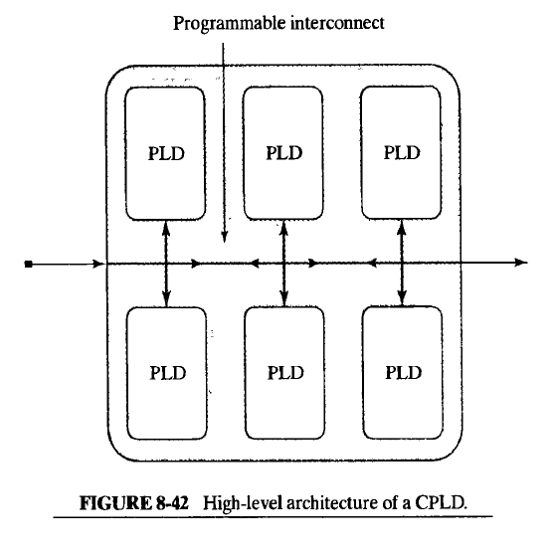
Complex Programmable Logic Devices

Slide 5
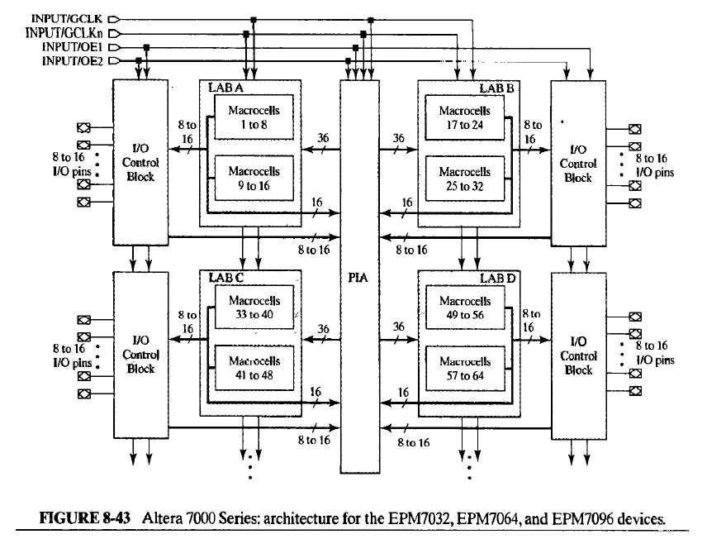

Slide 6
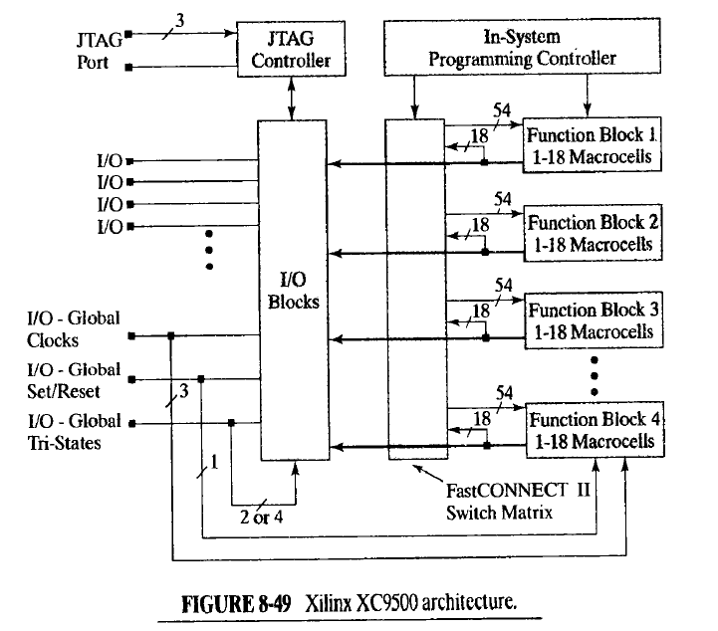

Slide 7
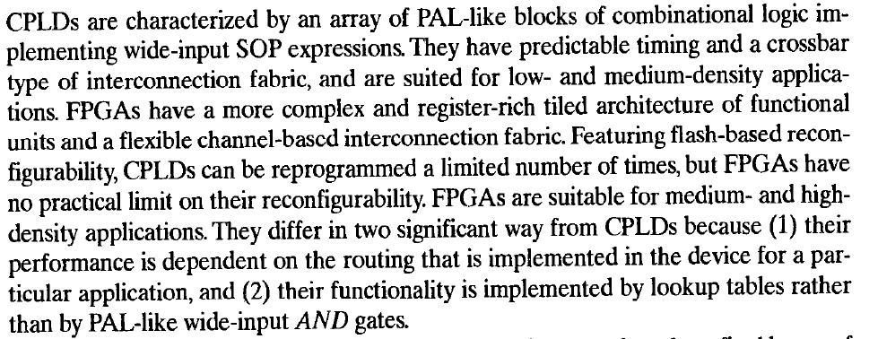
Finally, FPGA

Slide 8

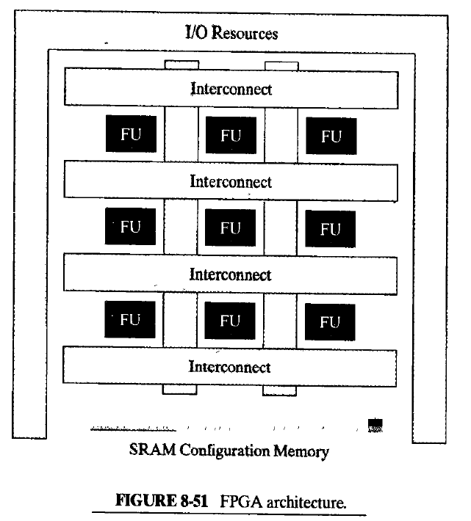

Slide 9



Slide 10
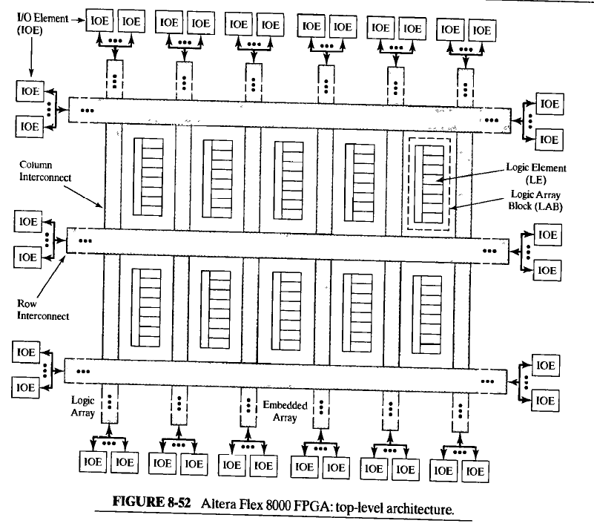

Slide 11
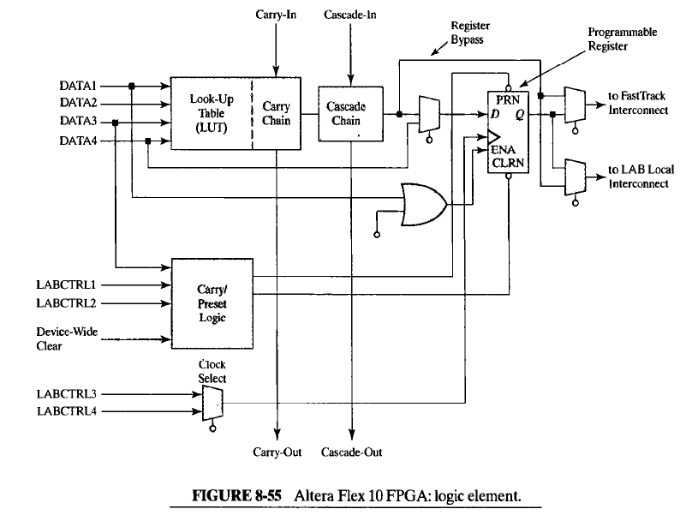

Slide 12
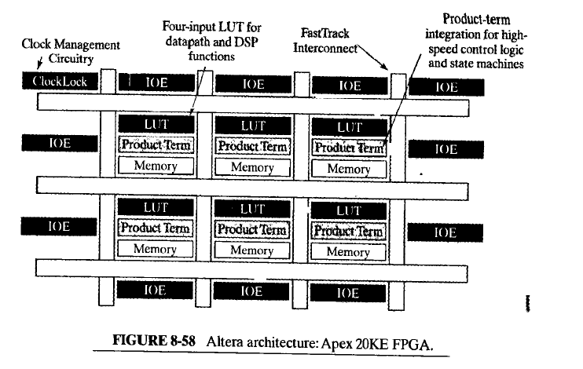

Slide 13
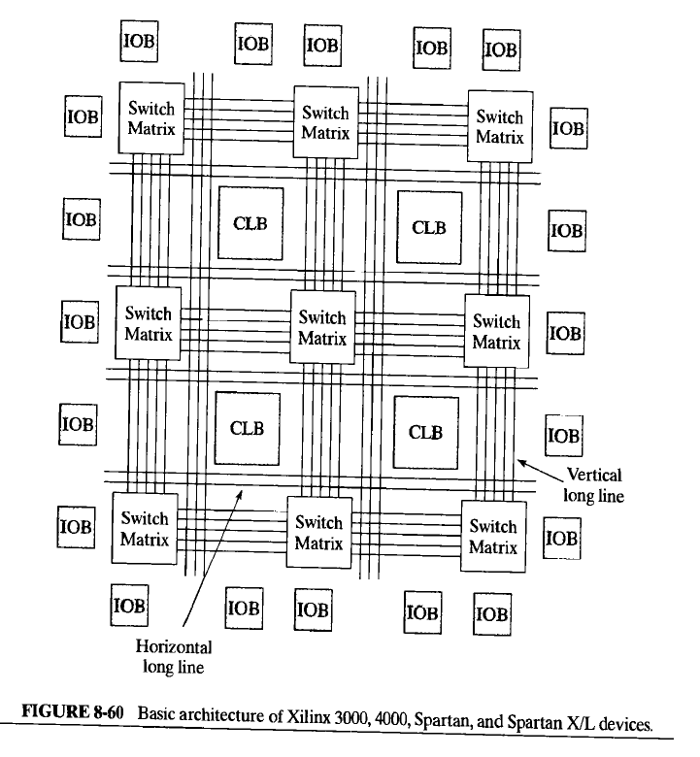

Slide 14
